Slide 1
18ECC203J – Module 1 Intel 8086 – Architecture, Signals and Features S – 7 (2 of 2), 8, 11, 12
Prepared by,
Dr. R. Manohari
Dr.T.Rajalakshmi

Slide 2
S – 7 (2 of 2) Methods of generating physical address in 8086 & Pin signals of 8086: Common signals
S – 8 Minimum mode signals & Maximum mode signals
S – 11 Minimum mode 8086 systems & Timings
S – 12 Maximum mode 8086 systems & Timings

Slide 3
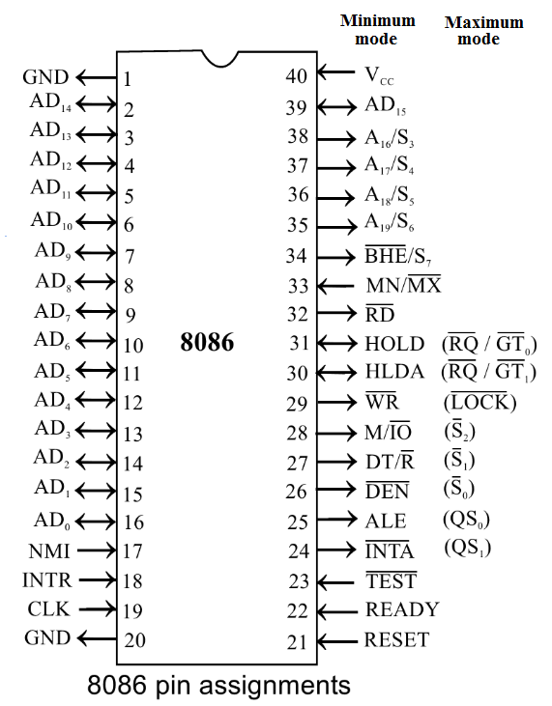
Pin Diagram of 8086 Microprocessor

Slide 4
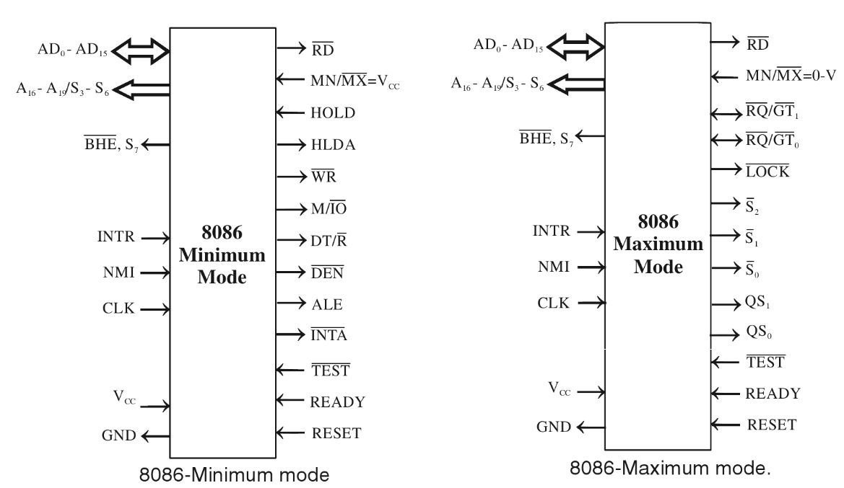
Two modes of 8086

Slide 5
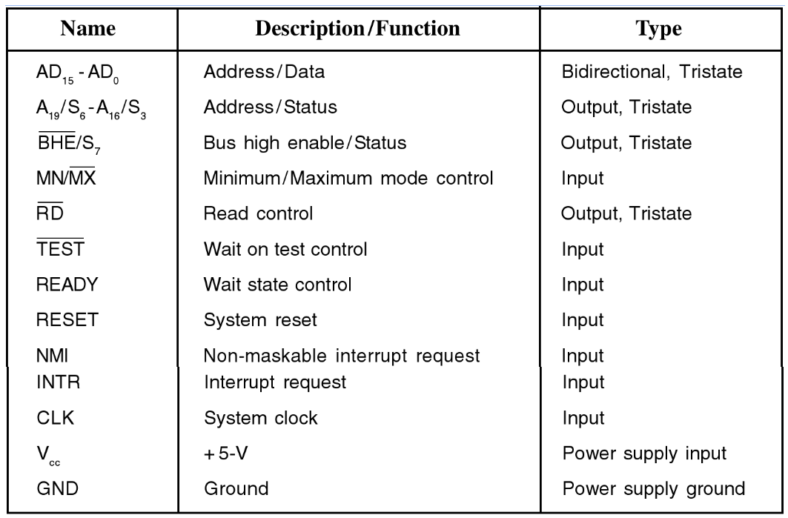
Common Signals in both modes

Slide 6
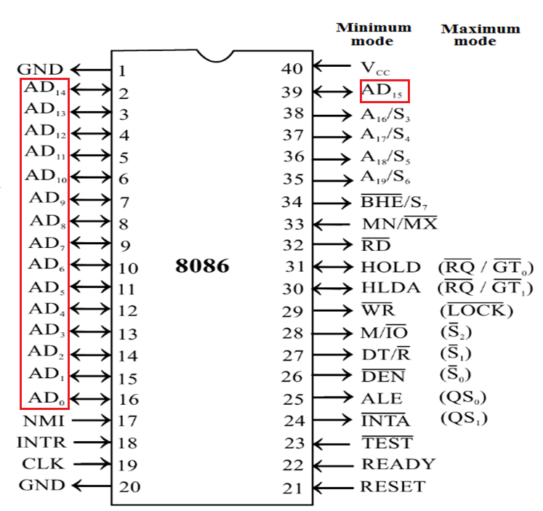
AD₀ – AD₁₅ Pin 16-2, 39 (Bi-directional)
These lines constitute the time multiplexed memory/IO address & data bus.
It acts as address bus during the first part of machine cycle(T₁) & data bus for the remaining part of the machine cycle

Slide 7
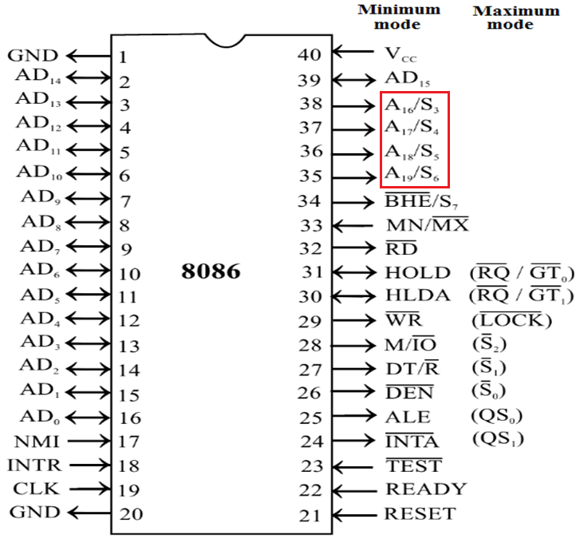
A₁₉/S₆, A₁₈/S₅, A₁₇/S₄, A₁₆/S₃ Pin 35-38 (Unidirectional)
These are the time multiplexed address and status lines
During T₁, they carry higher order 4-bit address.
In the remaining clock cycles, they carry status signals.

Slide 8
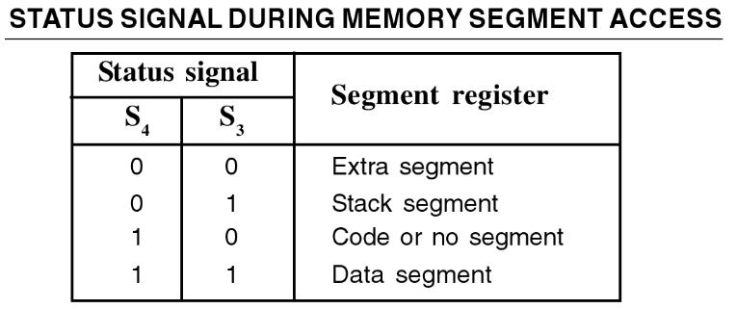
Cont.
The status signals on S₃ & S₄ specifies the segment register used for calculating the physical address
The status line S₅ indicates the status of an 8086 interrupt enable flag
The status line S₆ is always low

Slide 9
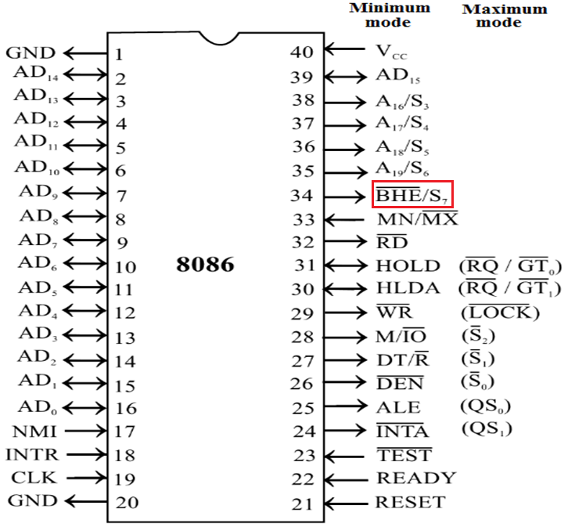
BHE / S₇ Pin 34 (Output)
BHE stands for Bus High Enable.
BHE signal is used to indicate the transfer of data over higher order data bus (D₁₅ – D₈).
It is multiplexed with status pin S₇.
S₇ is not currently used

Slide 10
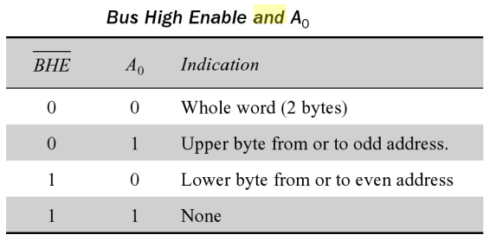
Cont.

Slide 11
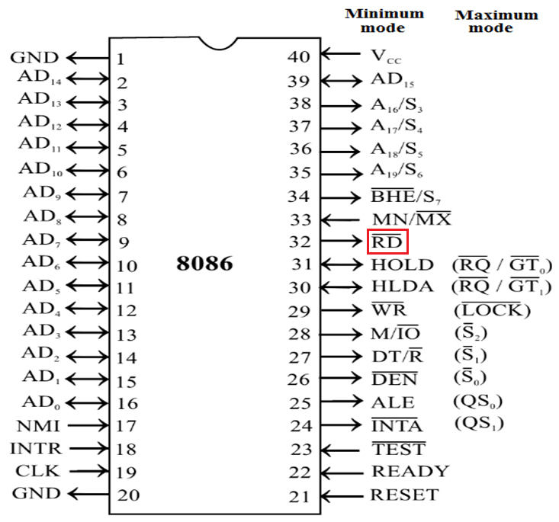
RD (Read) Pin 32 (Output)
It is a read signal used for read operation.
RD is low whenever the 8086 is reading data from memory or an I/O device

Slide 12
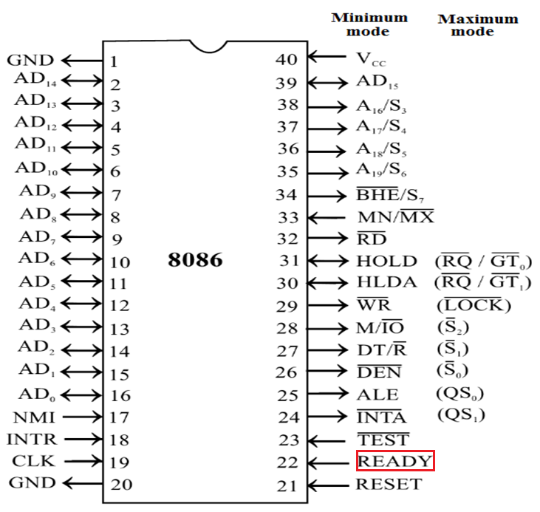
READY Pin 22 (Input)
This is an acknowledgement signal from slower I/O devices or memory.
When high, it indicates that the device is ready to transfer data.
When low, then microprocessor enters into wait state
This signal is used primarily to synchronize slower peripherals with the microprocessor

Slide 13
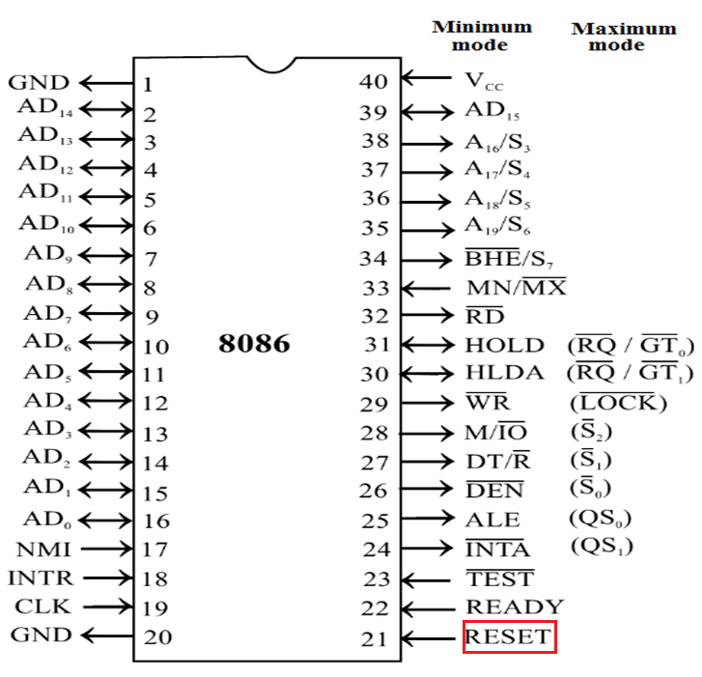
RESET Pin 21 (Input)
It is a system reset.
It is an active high signal.
When high, microprocessor enters into reset state and terminates the current activity and start execution from FFFF0H.
It must be active for at least four clock cycles to reset the microprocessor.

Slide 14
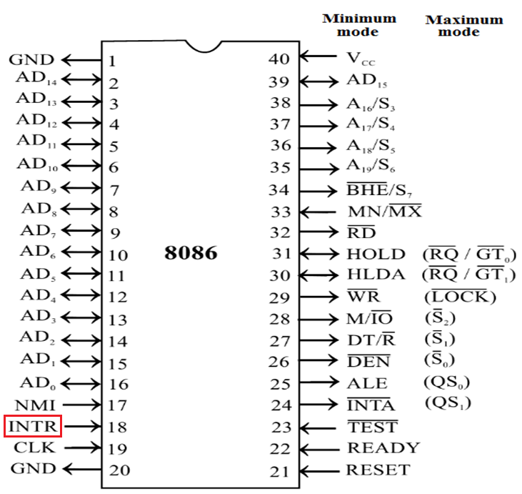
INTR Pin 18 (Input)
It is a level triggered maskable interrupt request.
It is sampled during the last clock cycle of each instruction to determine if the processor should enter into an interrupt service routine.

Slide 15
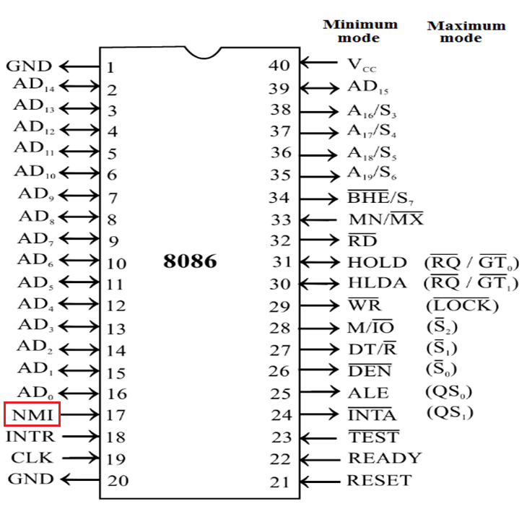
NMI Pin 17 (Input)
It is a positive edge triggered non-maskable interrupt request.
It causs a Type 2 interrupt.

Slide 16
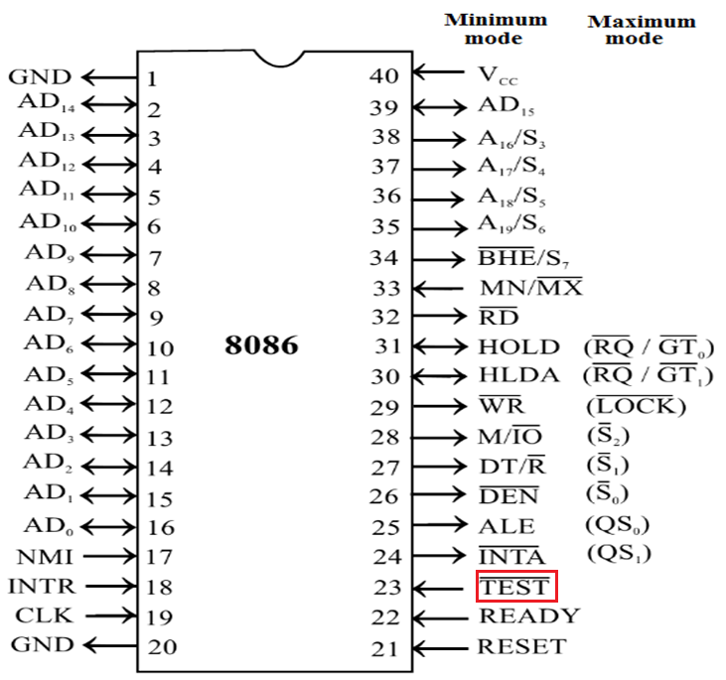
TEST Pin 23 (Input)
If low, execution continues else microprocessor enters into wait state
This input is examined by the ‘WAIT’ instruction
This input is synchronized internally during each clock cycle on the leading edge of the clock cycle

Slide 17

CLK Pin 19 (Input)
This clock input provides the basic timing for processor operation and bus control activity.
Clock frequency depends on the version of 8086
It requires clock signal ( with 33% duty cycle) from some external, crystal controlled generator to synchronize internal operations

Slide 18
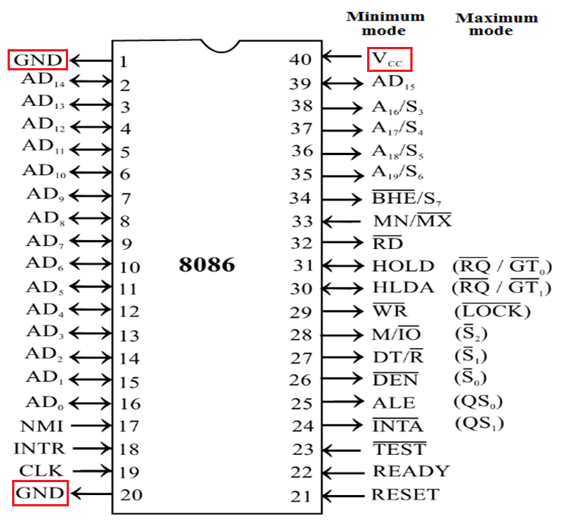
V_{CC} & GND Pin 40, 1 & 20
V_{CC}: +5 V power supply for the operation of the internal circuit
GND: ground for the internal circuit

Slide 19
Two modes of 8086 Minimum Mode Signals

Slide 20
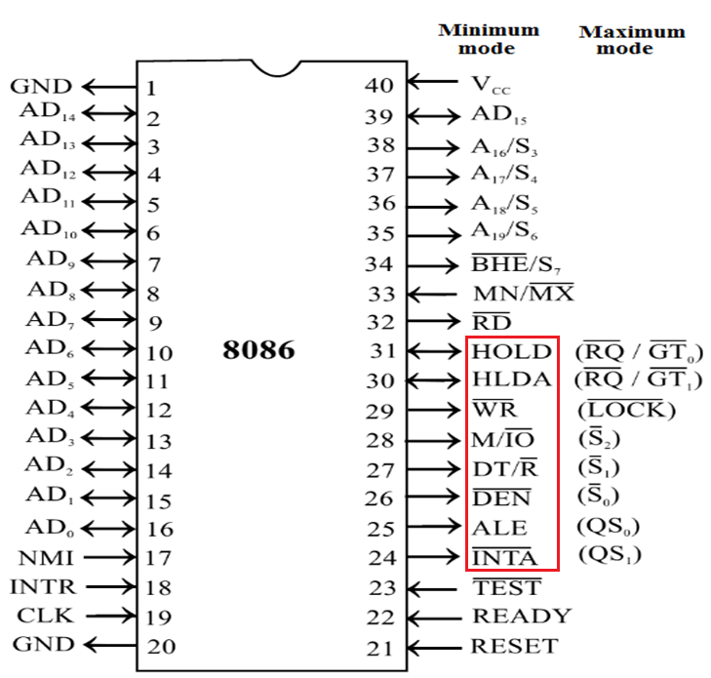
Minimum Mode Signals
For this mode, the MN/MX pin is tied to V_{CC} (logic high)
In this mode, the 8086 itself generates all bus control signals

Slide 21
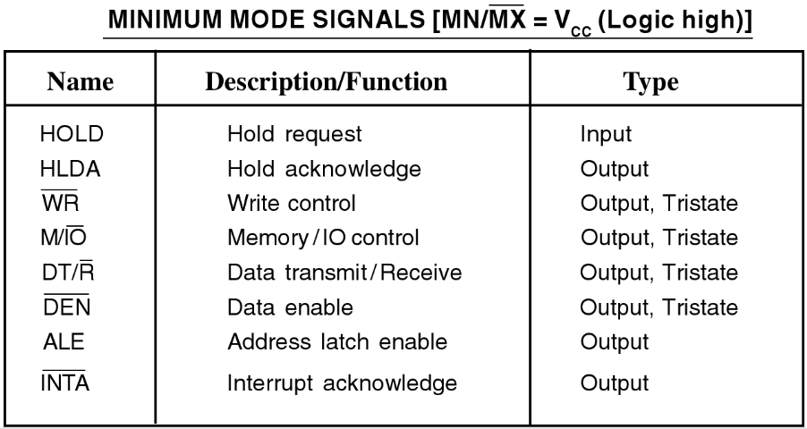
.

Slide 22
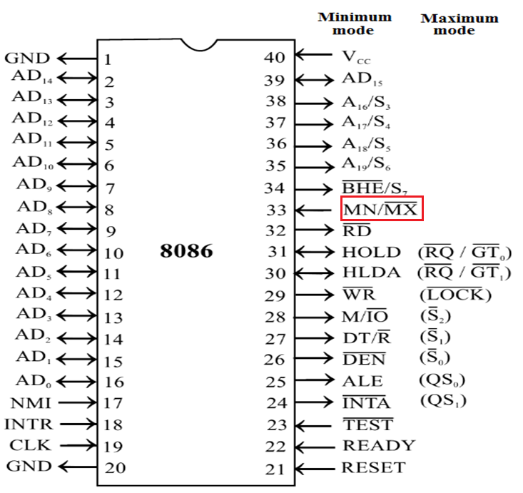
MN / MX Pin 33 (Input)
8086 works in two modes:
Minimum Mode
Maximum Mode
If MN/MX is high, it works in minimum mode.
If MN/MX is low, it works in maximum mode.

Slide 23
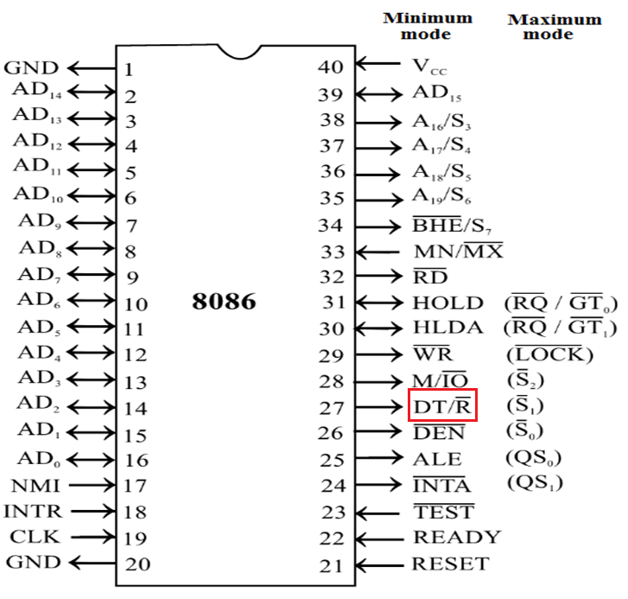
DT/R (Data Transmit/Receive) Pin 27 (Output)
This signal is used to decide the direction of data flow through the transceivers (bidirectional buffers)
When it is high, data is transmitted out by the processor
When it is low, data is received in by the processor
It is tristated during ‘hold acknowledge’ cycle.

Slide 24
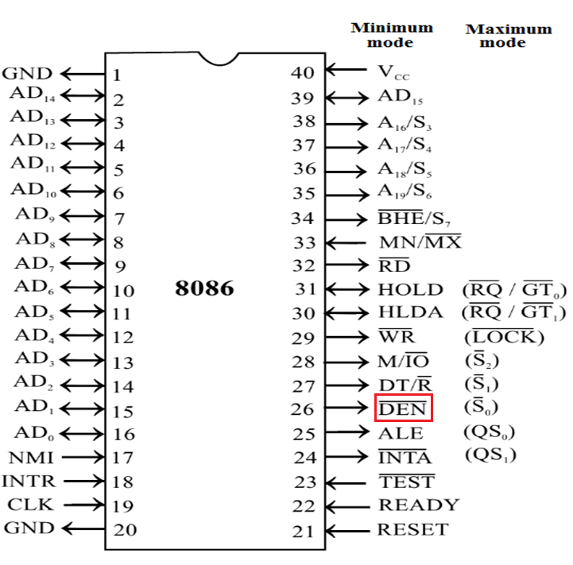
DEN (Data Enable) Pin 26 (Output)
This signal indicates the availability of valid data over the address/data lines.
It is used to enable the transceivers to separate the data from the multiplexed address/data signal.
It is active from the middle of T₂ until the middle of T₄.
It is tristated during ‘hold acknowledge’ cycle.

Slide 25
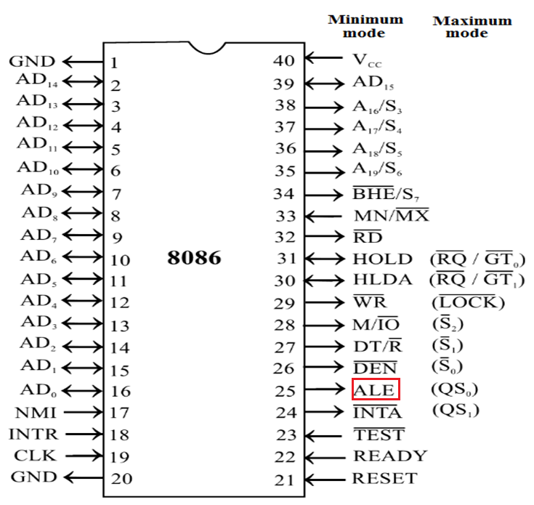
ALE (Address Latch Enable) Pin 25 (Output)
This output signal indicates the availability of the valid address on the address/data lines.
It is used to demultiplex the address and data lines using external latches
That is to demultiplex the AD₀-AD₁₅ into A₀-A₁₅ & D₀-D₁₅ using external latches
It is active high and is never tristated.

Slide 26
Cont.
The address bits are separated from the status bits using latches controlled by the ALE Signal

Slide 27
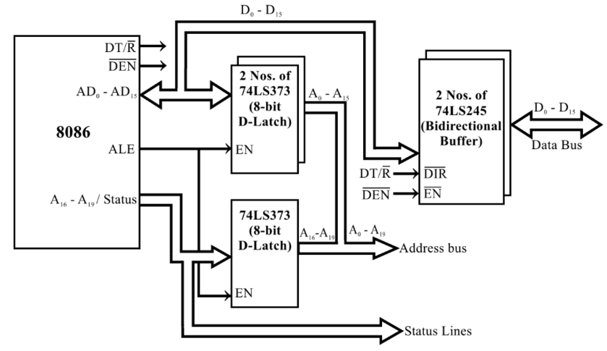
Demultiplexing of address and data lines in 8086 processor

Slide 28
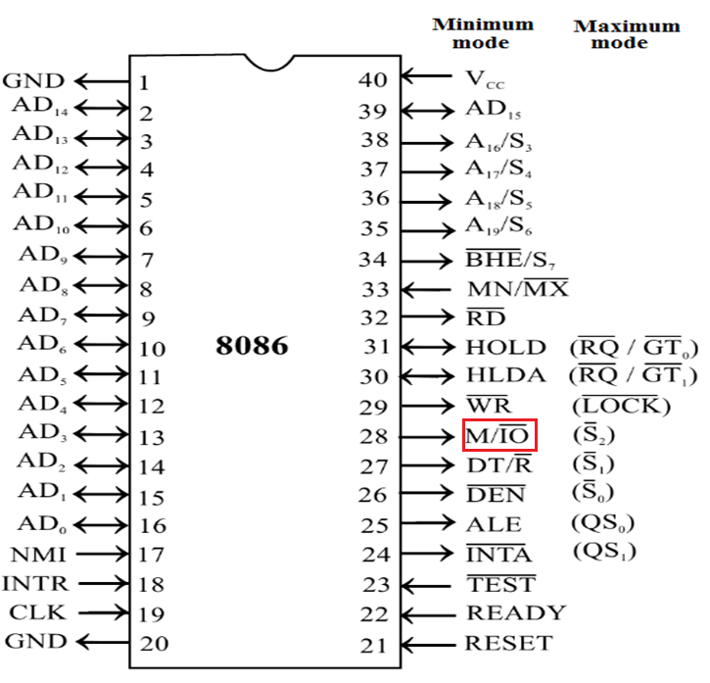
M / IO Pin 28 (Output)
It is used to differentiate memory access and IO access.
When it is high, memory is accessed.
When it is low, I/O devices are accessed.
It is tristated during ‘hold acknowledge’ cycle.

Slide 29
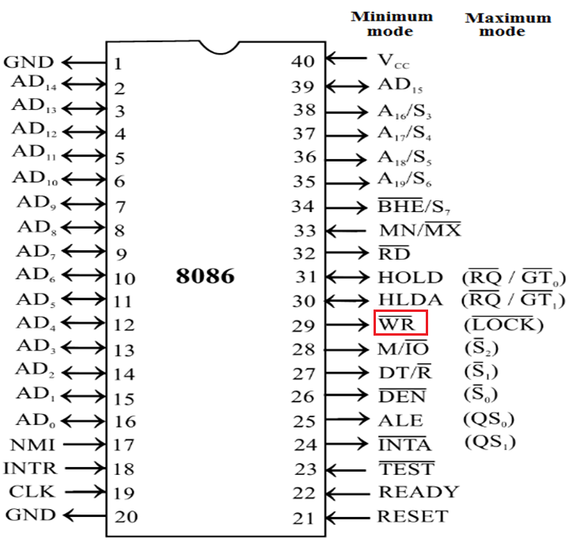
WR Pin 29 (Output)
It is a write control signal
It is asserted low whenever the processor writes data to memory or IO port

Slide 30
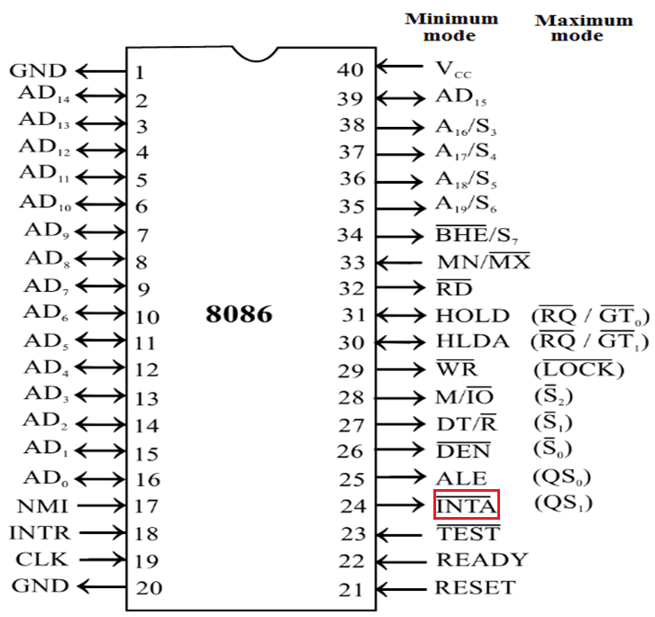
INTA (Interrupt Acknowledge) Pin 24 (Output)
This is an interrupt acknowledge signal.
When microprocessor receives INTR signal, it acknowledges the interrupt by generating this signal.
The 8086 output is asserted low on this line to acknowledge when the interrupt request is accepted by the processor
It is active low during T₂, T₃ and T_{w} of each interrupt acknowledge cycle

Slide 31
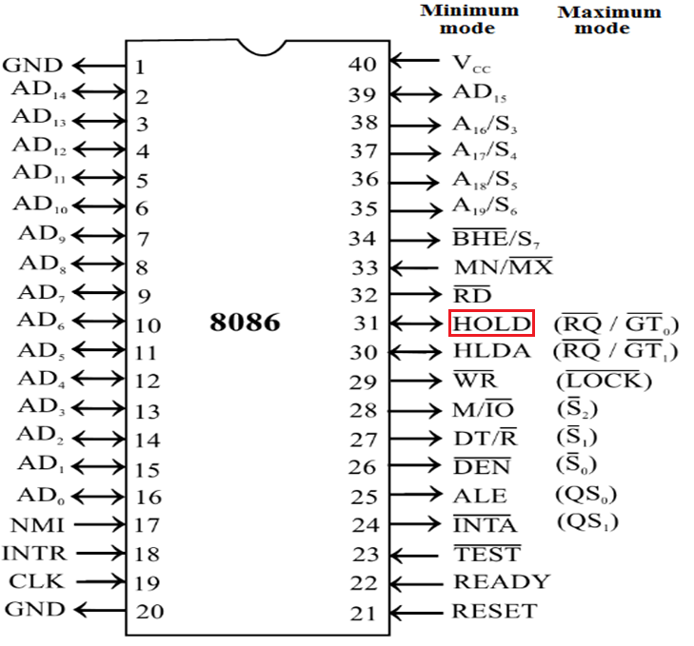
HOLD (Hold Request) Pin 31 (Input)
It is an input signal to the processor from other bus masters as a request to grant control of the bus.
It is usually used by the DMA controller to get the control of the bus

Slide 32
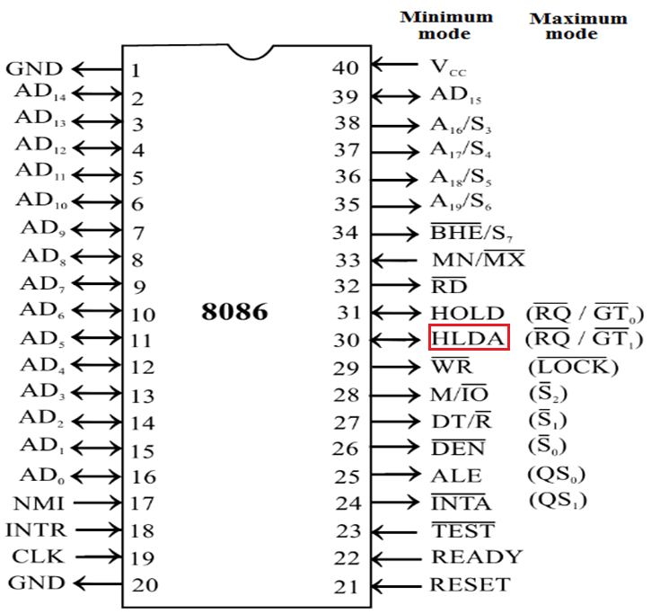
HLDA (Hold Acknowledge) Pin 30 (Output)
It is an acknowledge signal by the processor to the master requesting the control of the bus through HOLD.
The acknowledge is asserted high when the processor accepts the HOLD, in the middle of the next clock cycle after completing the current bus (instruction) cycle.

Slide 33
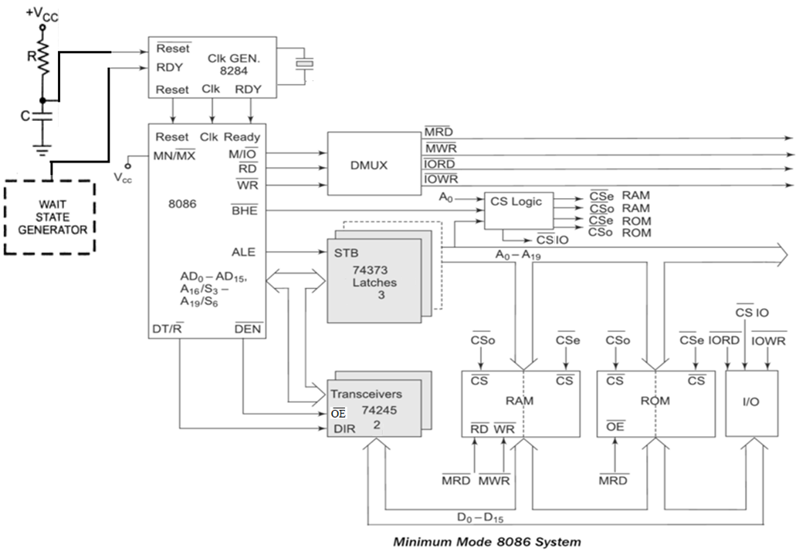
Minimum Mode 8086 System

Slide 34
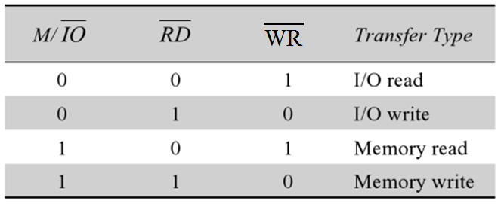
Cont.

Slide 35
Two modes of 8086 Maximum Mode

Slide 36
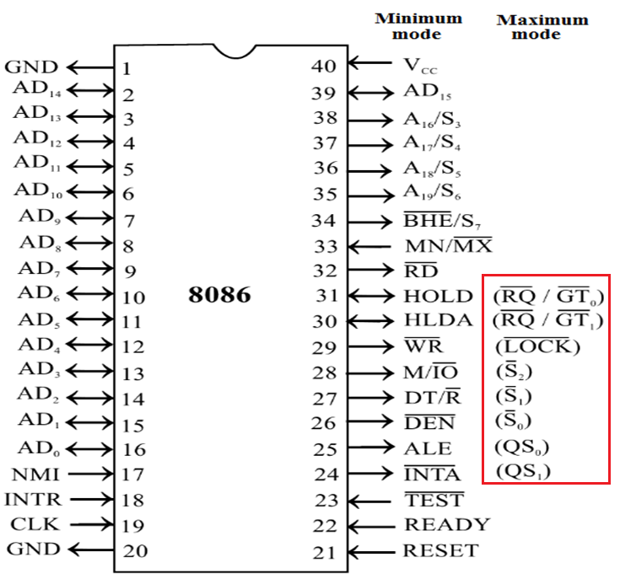
Maximum Mode Signals
For this mode, the MN/MX pin is tied to GND (logic low)

Slide 37
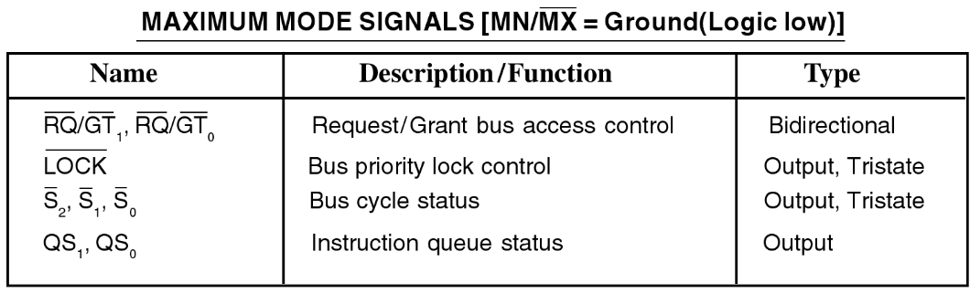

Slide 38
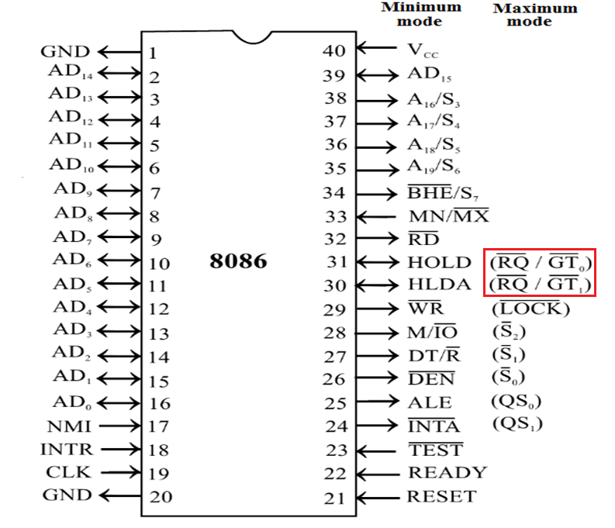
RQ/GT₁ and RQ/GT₀ Pin 30 and 31 (Bi-directional)
These are bus request/bus grant pins
Other local bus masters request the processor through these lines to release the system bus.
After receiving the request, processor sends acknowledge signal on the same lines.
RQ/GT₀ has higher priority than RQ/GT₁.
These pins have internal pull-up resistors and may be left unconnected.

Slide 39
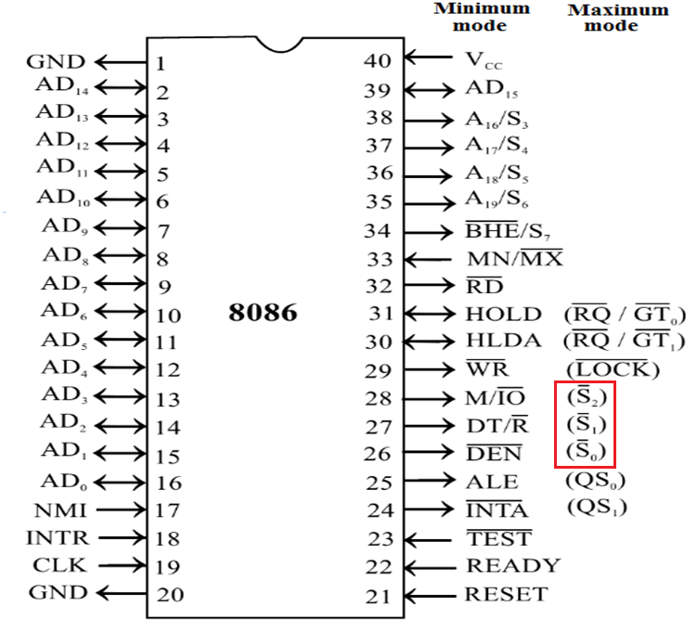
S₀, S₁, S₂ - Status Lines Pin 26, 27, 28 (Output)
These status signals indicate the type of operation being carried out by the microprocessor.
They are used by the 8288 bus controller to generate bus timing and control signals
These become active during T4 of the previous cycle and remain active during T1 and T2 of the current bus cycle.
The status lines return to passive state during T3 of the current bus cycle.

Slide 40
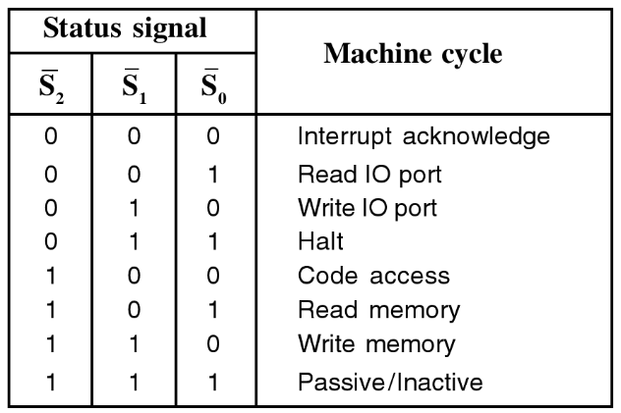
Status Signals (S₀, S₁, S₂) during various Machine Cycles

Slide 41
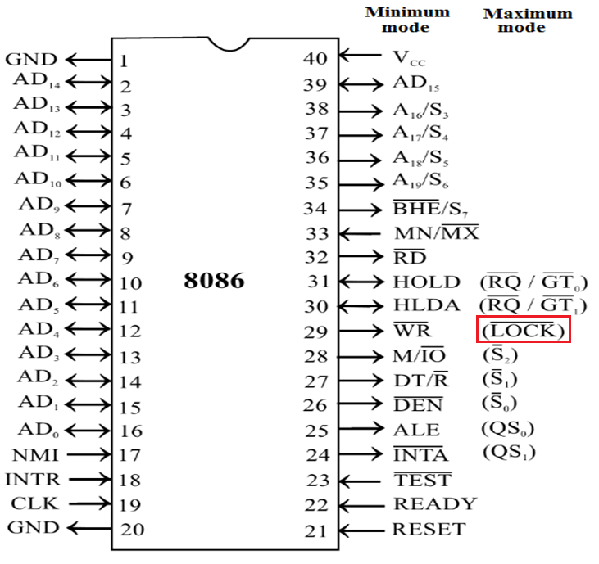
LOCK Pin 29 (Output)
This output pin indicates that other system bus masters will be prevented from gaining the system bus, while this signal is low.
When it goes low, all interrupts are masked.
This pin is activated by using LOCK prefix on any instruction and remains active until the completion of the next instruction.

Slide 42
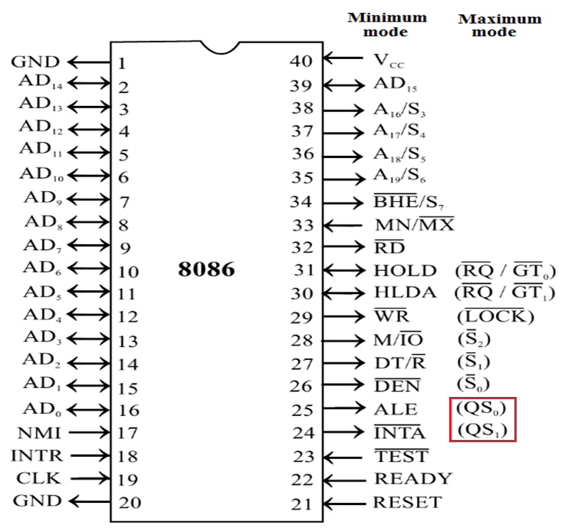
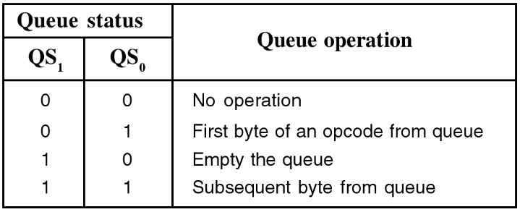
QS₁ and QS₀ (Queue Status) Pin 24 and 25 (Output)
These pins provide the status of instruction queue.

Slide 43
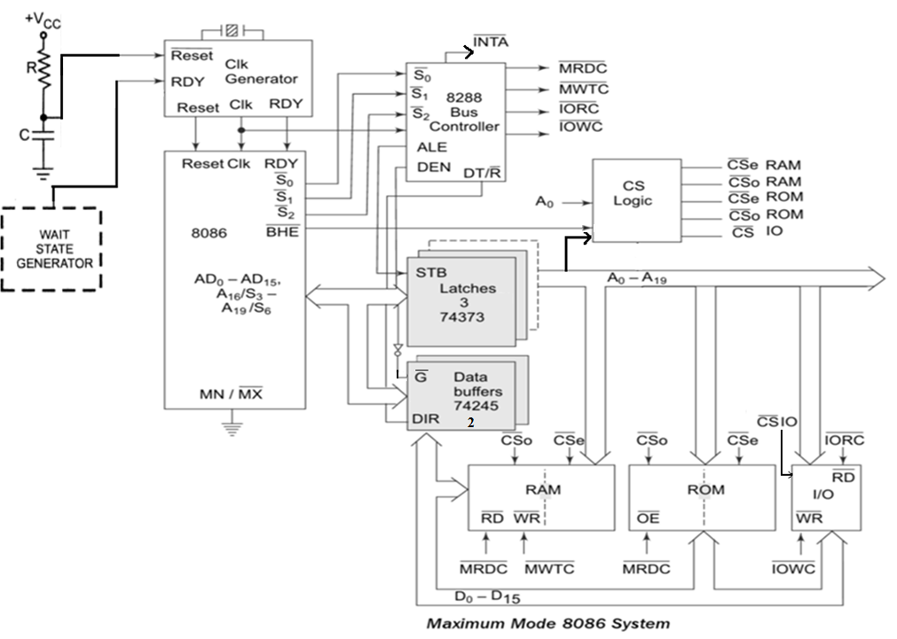
Maximum Mode 8086 System refer sl. 33

Slide 44
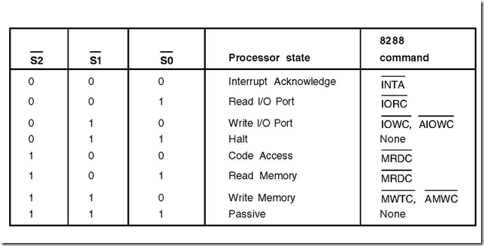
Status Signals (S₀, S₁, S₂) during various Machine Cycles

Slide 45
Signals of the 8288
IORC – I/O Read Command
IOWC – I/O Write Command
MRDC – Memory Read Command
MWTC – Memory Write Command
AIOWC – Advance I/O Write Command
AMWTC – Advance Memory Write Command
INTA – Interrupt Acknowledge
DEN, ALE, DT/R

Slide 46
Timing Diagram
Timing Diagram is a graphical representation.
It represents the execution time taken by each instruction in a graphical format.
The execution time is represented in T-states.
Instruction Cycle: The time required to execute an instruction
Machine Cycle: The time required to access the memory or input/output devices
T-State: A portion of an operation carried out in one system clock period

Slide 47
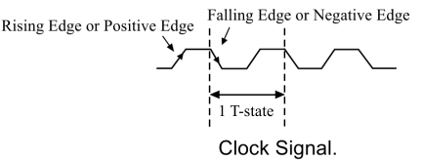
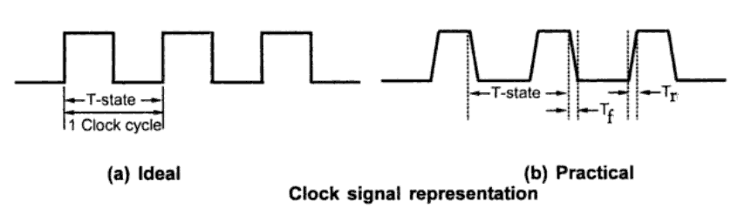
T-State

Slide 48

Timing Diagram
Timing diagram provides information about the various conditions of the signals while a machine cycle is executed.
In other words, it is the representation of various control signals generated during execution of an instruction
Following Buses and Control signals must be shown in a Timing diagram:
Higher Order Address Bus, Lower Address/Data bus, ALE,

Slide 49
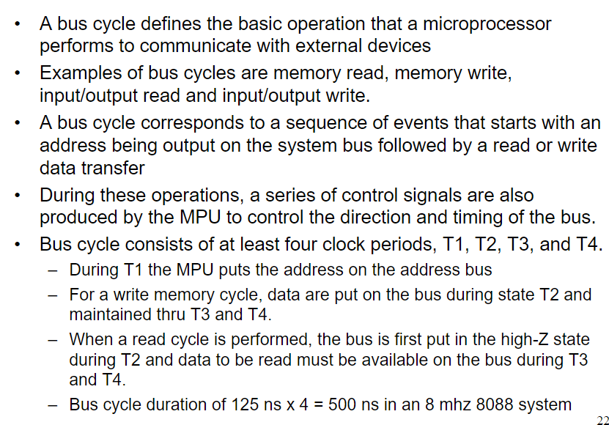
Bus cycle and T states

Slide 50
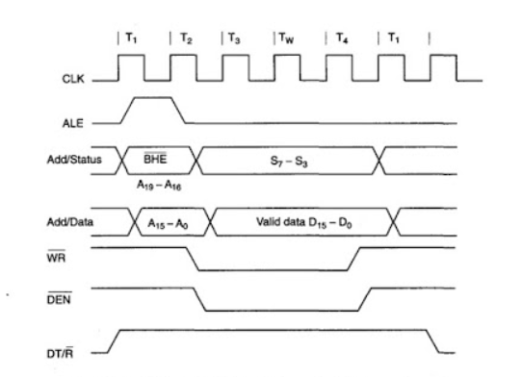
Timing Diagram : Write cycle – Minimum mode

Slide 51
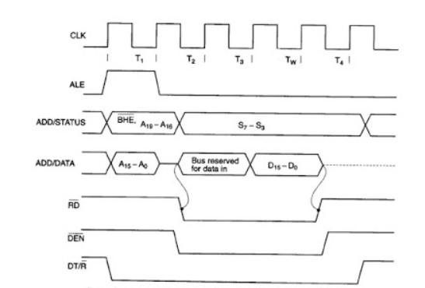
Timing Diagram : Read cycle – Minimum mode

Slide 52
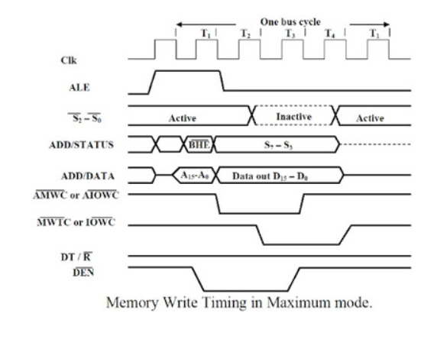
Timing Diagram : Write cycle – Maximum mode

Slide 53
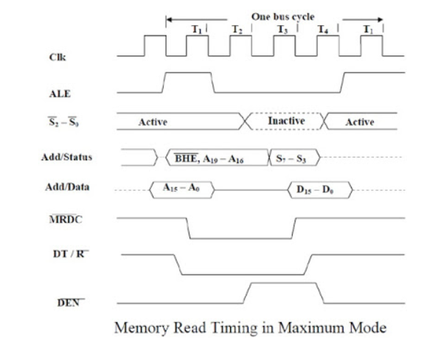
Timing Diagram : Read cycle – Maximum mode

Slide 54
References
Advanced Microprocessors and Peripherals by A K Ray & K M Bhurchandi
Microprocessors and Interfacing by Douglas V Hall & SSSP Rao

Slide 55
Thank You

